Slide 1
MCA-II (Semester- III) Subject :- Software Testing & Quality Assurance (Subject Code:- IT-33) Chapter: 3] Static Testing
Prof. Sachin Lende

Slide 2
3.1. Static Techniques – Review
3.1.1 Review Process (Informal & Formal)
Static Testing is a software testing technique which is used to check defects in software application without executing the code. Static testing is done to avoid errors at an early stage of development as it is easier to identify the errors and solve the errors.

Slide 3
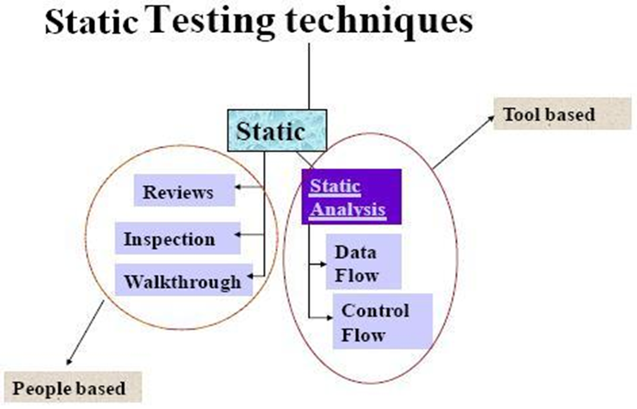

Slide 4
A review in a Static Testing is a process or meeting conducted to find the potential defects in the design of any program. Another significance of review is that all the team members get to know about the progress of the project and sometimes the diversity of thoughts may result in excellent suggestions.

Slide 5
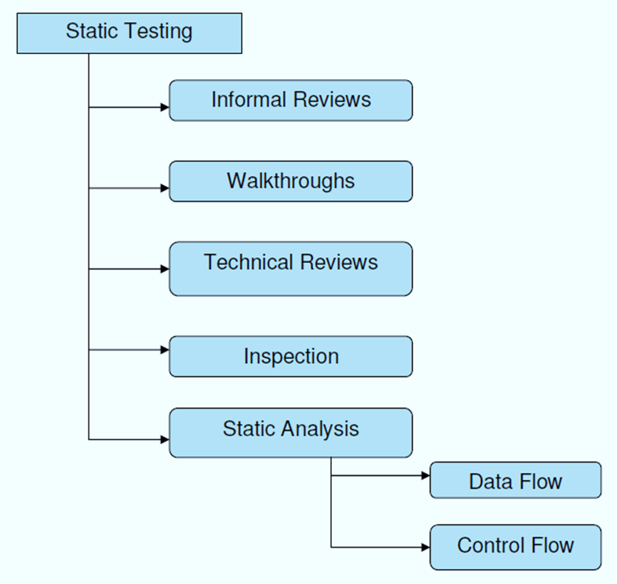

Slide 6
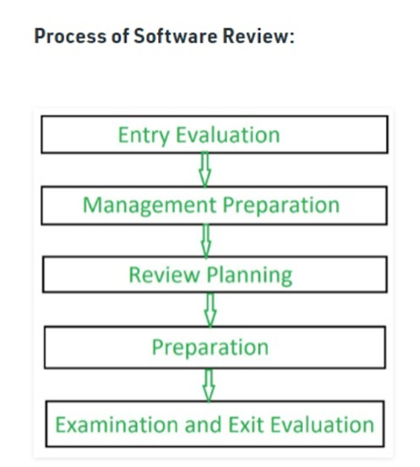

Slide 7
Formal Review:
A type of peer review, "formal review" follows a formal process and has a specific formal agenda. It has a well structured and regulated process, which is usually implemented at the end of each life cycle. During this process, a formal review panel or board considers the necessary steps for the next life cycle.
Features of Formal Review:
This evaluates conformance to specification and various standards.
Conducted by a group of 3 or more individuals.
The review team petitions the management of technical leadership to act on the suggested recommendations.

Slide 8
Formal review consists steps, which are:
Planning.
Kick-off.
Preparation.
Review meeting.
Rework.
- Follow up

Slide 9
Informal Review:
Unlike Formal Reviews, Informal reviews are applied multiple times during the early stages of software development process. The major difference between the formal and informal reviews is that the former follows a formal agenda, whereas the latter is conducted as per the need of the team and follows an informal agenda. Though time saving, this process is not documented and does not require any entry criteria or large group of members.

Slide 10
Features of Informal Review:
Conducted by a group of 2-7 members, which includes the designer an any other interested party.
Here the team identifies errors & issues as well as examine alternatives.
It is a forum for learning.
All the changes are made by the software designer.
These changes are verified by other project controls.
The role of informal review is to keep the author informed and to improve the quality of the product

Slide 11
Informal reviews | Formal reviews
It is a type of review that typically occurs spontaneously among teams. | It is a type of review that is done by a team of software testers or the reviewer’s team.
It is generally done by Software developers or engineers. | It is done by the Reviewers and they are responsible for this all review.
Here, no report is created as it is informal. | Here, a report is created as it is formal.

Slide 12
3.1.2 Desk Checking
Desk checking is an informal manual test that programmers can use to verify coding and algorithm logic before a program launch. This enables them to spot errors that might prevent a program from working as it should. Modern debugging tools make desk checking less essential than it was in the past, but it can still be a useful way of spotting logic errors.

Slide 13
Desk checking is a similar process to proofreading; in this exercise, the programmer runs through lines of code to identify errors and to check logic. Typically, the programmer will print out the code and go through it in a pencil and paper exercise. He may run a manual test on algorithms, checking that they work correctly and contain no coding errors. This usually involves creating a table with columns containing line numbers, variables, conditions, and inputs and outputs, depending on the checks he is making.

Slide 14
What is Technical review?
A Technical review is a static white-box testing technique which is conducted to spot the defects early in the life cycle that cannot be detected by black box testing techniques.
A software technical review is examined by a team of qualified software engineers for the suitability of the software product. This process can also be defined as a critical evaluation of an object in the software. Through the software technical review process, we can identify the errors or defects in the software product in the early phase itself.

Slide 15
What is Peer Review?
A peer review, a review technique, which is a static white-box testing which are conducted to spot the defects early in the life cycle that cannot be detected by black box testing techniques.
Peer review is the process of assessing the technical content and quality of the product and it is usually conducted by the author of the work product along with some other developers

Slide 16
3.1.4 Walkthrough
Walkthrough is a method of conducting informal group/individual review. In a walkthrough, author describes and explain work product in a informal meeting to his peers or supervisor to get feedback. Here, validity of the proposed solution for work product is checked.
It is cheaper to make changes when design is on the paper rather than at time of conversion. Walkthrough is a static method of quality assurance. Walkthrough are informal meetings but with purpose.
in which a designer or programmer leads members of the development team and other interested parties through a software product, and the participants ask questions and make comments about possible errors, violation of development standards, and other problems.

Slide 17
Walkthrough Participants:
Author - The Author of the document under review.
Presenter - The presenter usually develops the agenda for the walkthrough and presents the output being reviewed.
Moderator - The moderator facilitates the walkthrough session, ensures the walkthrough agenda is followed, and encourages all the reviewers to participate.
Reviewers - The reviewers evaluate the document under test to determine if it is technically accurate.
Scribe - The scribe is the recorder of the structured walkthrough outcomes who records the issues identified and any other technical comments, suggestions, and unresolved questions

Slide 18
3.1.5 Inspection
An inspection is defined as formal, rigorous, in depth group review designed to identify problems as close to their point of origin as possible. Inspections improve reliability, availability, and maintainability of software product.
Anything readable that is produced during the software development can be inspected. Inspections can be combined with structured, systematic testing to provide a powerful tool for creating defect-free programs.

Slide 19
Stages in the inspections process :
Planning : Inspection is planned by moderator.
Overview meeting : Author describes background of work product.
Preparation : Each inspector examines work product to identify possible defects.
Inspection meeting : During this meeting, reader reads through work product, part by part and inspectors points out the defects for every part.
Rework : Author makes changes to work product according to action plans from the inspection meeting.
Follow-up : Changes made by author are checked to make sure that everything is correct.

Slide 20
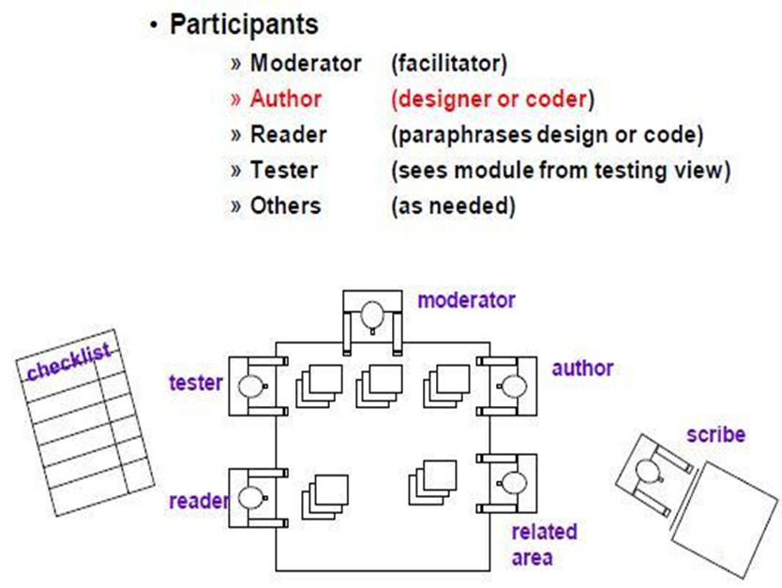

Slide 21
3.2.1 Data Flow Analysis
Data-flow analysis is a technique for gathering information about the possible set of values calculated at various points in a computer program. It attempts to obtain particular information at each point in a procedure. Usually, it is enough to obtain this information at the boundaries of basic blocks, since from that it is easy to compute the information at points in the basic block

Slide 22
It is the analysis of flow of data in control flow graph, i.e., the analysis that determines the information regarding the definition and use of data in program. With the help of this analysis, optimization can be done. In general, its process in which values are computed using data flow analysis. The data flow property represents information that can be used for optimization

Slide 23
Data Flow testing helps us to pinpoint any of the following issues:
A variable that is declared but never used within the program.
A variable that is used but never declared.
A variable that is defined multiple times before it is used.
De-allocating a variable before it is used.

Slide 24
3.2.2 Control-Flow Analysis (CFA)
It is a static-code-analysis technique for determining the control flow of a program. The control flow is expressed as a control-flow graph (CFG).
Control flow testing is a testing technique that comes under white box testing. The aim of this technique is to determine the execution order of statements or instructions of the program through a control structure. The control structure of a program is used to develop a test case for the program. In this technique, a particular part of a large program is selected by the tester to set the testing path. It is mostly used in unit testing. Test cases represented by the control graph of the program.

Slide 25
Notations used for Control Flow Graph
Node
Edge
Decision Node
Junction node

Slide 26
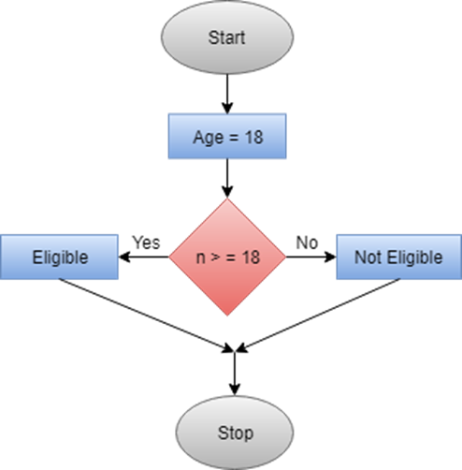

Slide 27
Control Flow Graph is a graphical representation of control flow or computation that is done during the execution of the program.
Control flow graphs are mostly used in static analysis as well as compiler applications, as they can accurately represent the flow inside of a program unit.

Slide 28
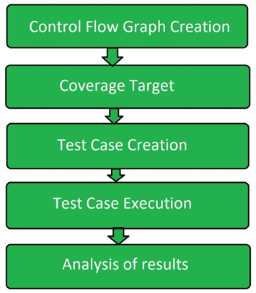

Slide 29
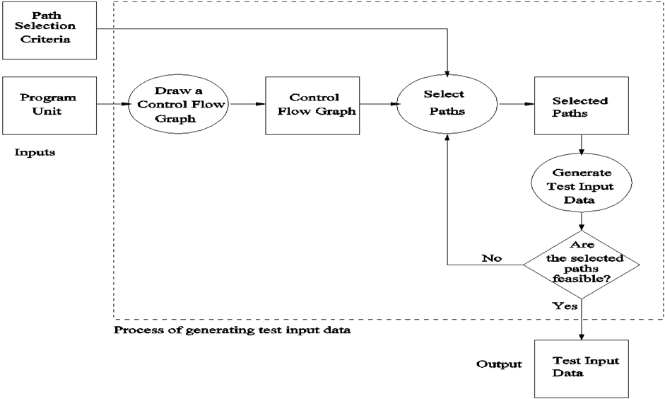

Slide 30
3.2.3 Static Analysis by Tools (Automated Static Analysis)
Static analysis tools refer to a wide array of tools that examine source code, executable, or even documentation, to find problems before they happen; without actually running the code. These tools vary greatly in scope and purpose, ranging from compiler-level checks for logical errors, to code styling enforcement, to cloud-based suites of tools that cover everything from documentation formatting to code complexity analysis.

Slide 31
Static code Analysis Tools
AdaControl :-
A tool to control occurrences of various entities or programming patterns in Ada code, used for checking coding standards, enforcement of safety related rules, and support for various manual inspections. Features automatic fixing of violations.
Apache Yetus :-
A collection of build and release tools. Included is the 'precommit' module that is used to execute full and partial/patch CI builds that provides static analysis of code via other tools as part of a configurable report. Built-in support may be extended with plug-ins.It is supported by Java & Python
Astree :-
Finds all potential runtime errors and data races by abstract interpretation, can prove their absence, and can prove functional assertions; tailored towards safety-critical C code
Code Peer
An advanced static analysis tool that detects potential run-time logic errors in Ada programs.
Code Scene:-
Behavioral analysis of code. Helps identify, prioritize, and manage technical debt. Measures organizational aspects of developer teams. Automated pull request integrations. It is supported by various programming languages as C,C++ ,C#, Java

